Slide 1


IRONHACK
Project 2
CUSTOMER DIGITAL EXPERIMENT
SPEAKER: ROY JOANNIDES

Slide 2

Vanguard
Presentation Outline
01
Vanguard and the project brief
05
Hypothesis Testing
02
Data Overview
06
Experiment Evaluation
03
Exploratory Data Analysis (EDA)
07
Tableau Visualizations
04
Performance Metrics
08
Conclusions

Slide 3
Vanguard
About Vanguard
GLOBAL INVESTMENT MANAGEMENT
Vanguard is one of the world's most respected investment management companies, offering a broad selection of investments, advice, retirement services, and insights to individual investors, institutions, and financial professionals

Slide 4

Vanguard
Project Brief
EXPERIMENT CONTEXT
A more intuitive and modern User Interface (UI)- user system, could make the online process smoother for clients.
KPI's:
Completion rate
Time spent
Error rate
CHALLENGE
Does our new User Interface (UI) facilitate online processes?

Slide 5
Vanguard
DATA
Clients: 70609
Client demographics | Experiment Roster (Test & Control ) | Trace of client interactions
Test time: 3 months

Slide 6
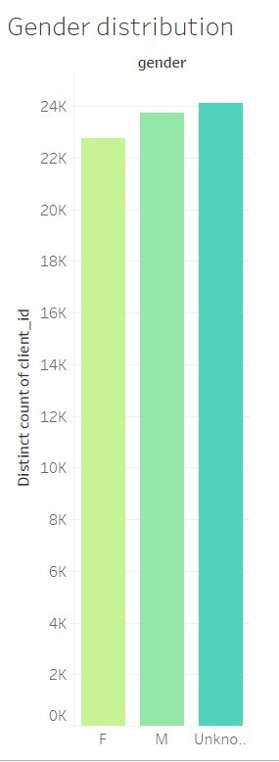
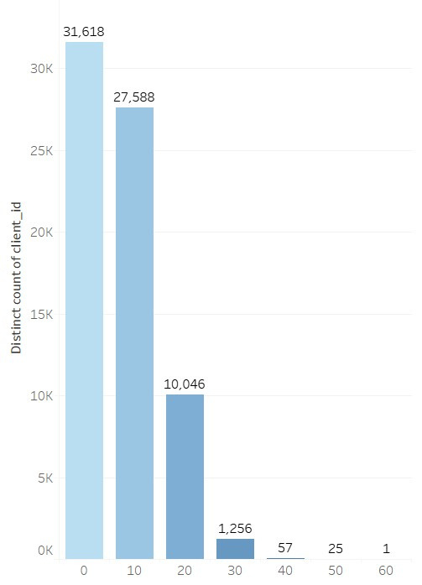
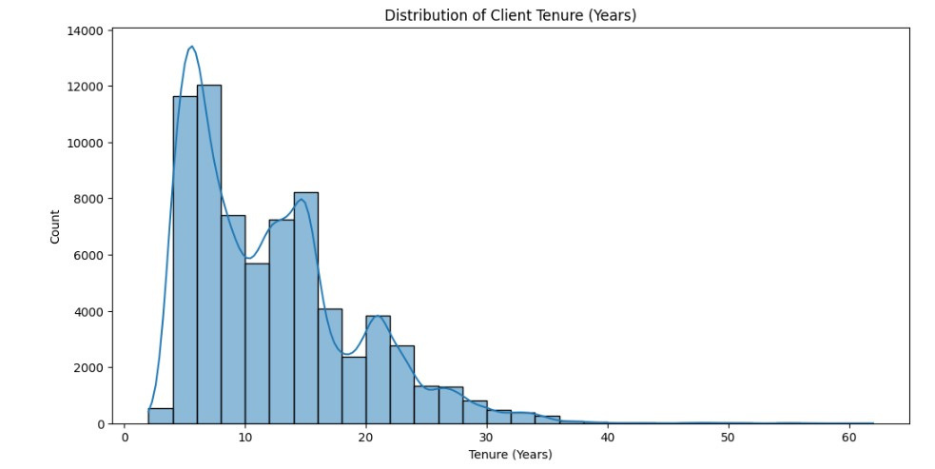
Vanguard
EDA
Client Tenure
Gender distribution
Average Tenure of Clients: 12 years
05 - 10

Slide 7
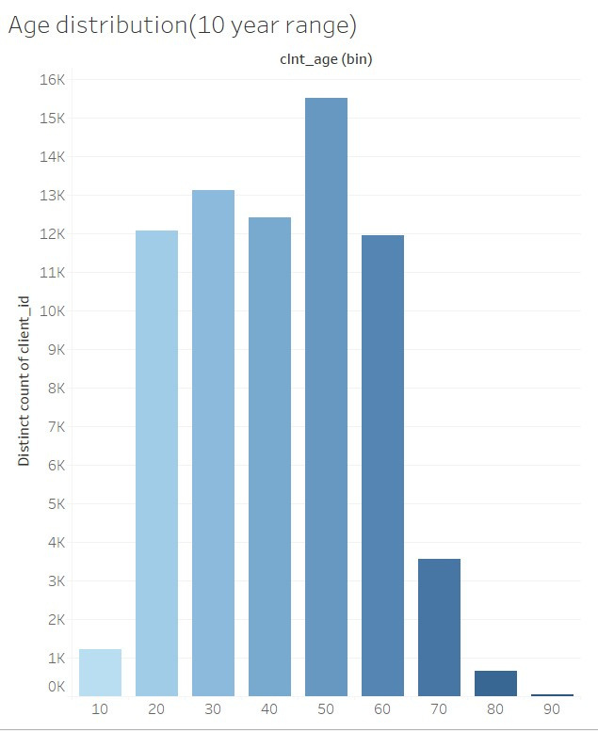
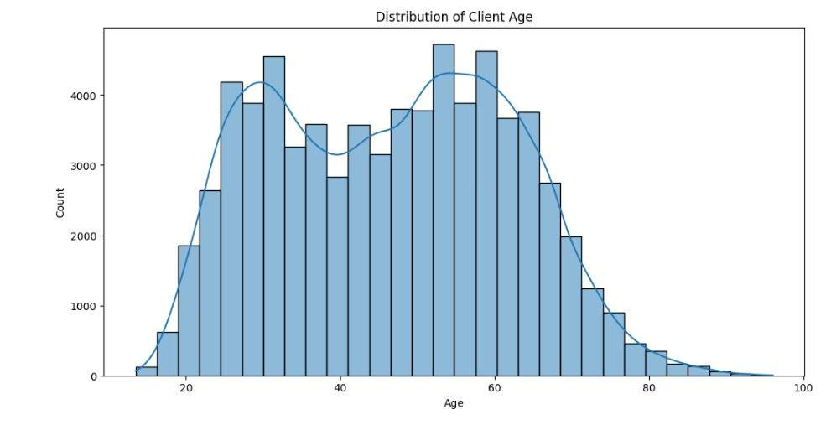
Vanguard
EDA
Client age distribution
Average Age of Clients: 46.44 years
05 - 10

Slide 8
Vanguard
Tableau Visualizations
CLICK TO SEE WORKBOOK

Slide 9

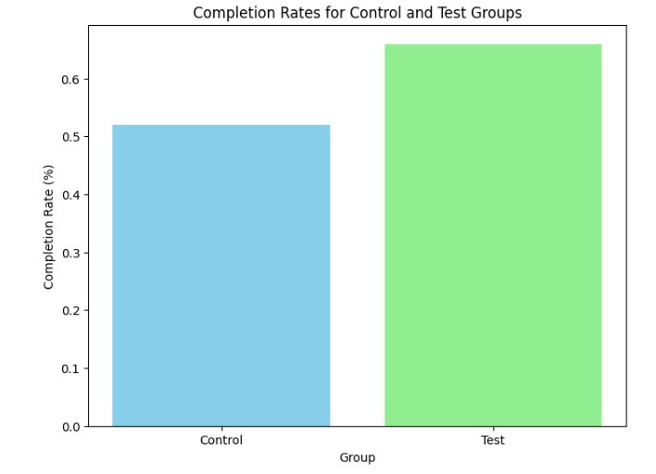
Performance Metrics and Testing
Vanguard
COMPLETION RATE
Null Hypothesis (H0): There is no difference in completion rates between the Test and Control groups.
Alternative Hypothesis (H1): There is a difference in completion rates between the Test and Control groups.
Z-statistic: -35.113623085561784
P-value: 4.17670253075403e-270
Reject the null hypothesis: There is a difference in completion rates.

Slide 10
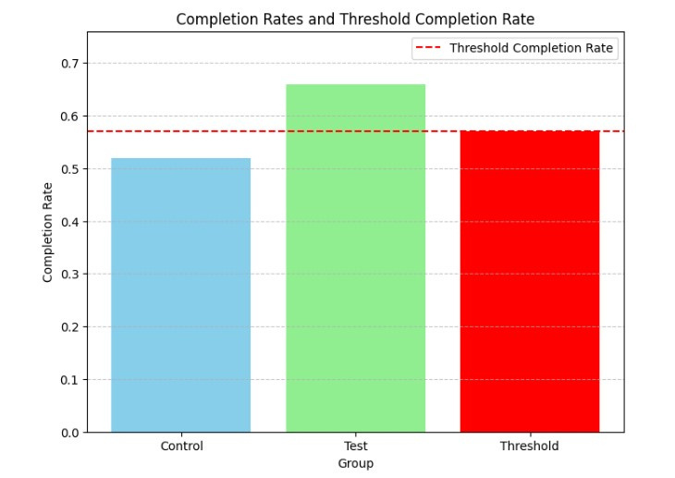
Performance Metrics and Testing
Vanguard
COMPLETION RATE WITH 5% THRESHOLD
- z-statistic: 35.113623085561784
- p-value: 2.088351265377015e-270
Reject Null Hypothesis: The new design leads to a completion rate increase greater than 5% and is cost-effective.

Slide 11
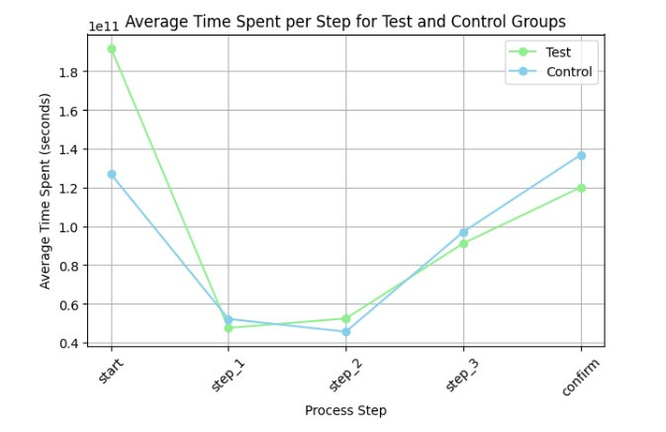
Performance Metrics
Vanguard
TIME SPENT (PER STEP AND MEAN TOTAL PROCESS)
Mean total process time
Average Time Spent for Test Group:
00:05:07
Average Time Spent for Control Group:
00:05:08

Slide 12
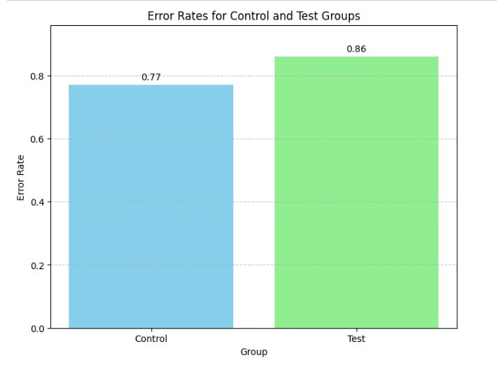
Performance Metrics
Vanguard
ERROR RATES
Error rate for control group: 0.77
Error rate for test group: 0.86

Slide 13

Vanguard
Experiment Evaluation
Design Effectiveness:
Well-structured, Clear objectives
Defined key performance indicators (KPIs) to measure the effectiveness of the UI redesign.
Distribution of Clients was randomized and fairly equal
Bias was minimized through the randomization process and by ensuring that all clients had an equal chance of being assigned to either the control or test group.
Duration Assessment:
The three-month duration allowed for sufficient time to capture user interactions and behaviors across different time periods, including weekdays and weekends.
08 - 10

Slide 14
Vanguard
Conclusions
Based on KPI's:
Completion rate: TEST performed better
Time Spent: TEST performed better
Error rate: CONTROL performed better
Recommendations
Error rate could be studied further with more data
Gathering user feedback for qualitative insights into user perceptions of the redesign (areas for improvement.)
User demographics like geographic location to provide insights into how different users interact with the redesigned interface.

Slide 15

Vanguard
Thank You

